Slide 1

Introduction to .Net
By
Sam Nasr
May 5, 2006
www.ClevelandDotNet.info

Slide 2
Agenda
Introductions
What is .Net?
.Net Framework
Advantages of .Net
Advantages of CLR
Visual Studio 2005
.Net Languages
C# vs. VB.Net
Resources

Slide 3
What is .Net?
New programming methodology
  Multiple Languages (VB.Net, C#, J#, Cobol.Net, etc.)
  JIT Compiler
Primary Parts:
  .Net Framework
  Common Language Runtime (CLR)
RTM:
  2002 (v1.0)
  2003 (v1.1)
  2005 (v2.0)
Notes:
CLR also includes the Just-In-Time (JIT) compiler.

Slide 4
.Net Framework
A set of approximately 3500 classes.
Classes are divided into namespaces grouping similar classes.
For organization, each class belongs to only one namespace.
Most classes are lumped into a name space called System
  System.Data: DB access
  System.XML: reading/writing XML
  System.Windows.Forms: Forms manipulation
  System.Net: network communication.

Slide 5
.Net Framework
Supports Web Standards
  HTML
  XML
  XSLT
  SOAP
  WSDL (Web Services)
ADO.Net: ActiveX Data Objects
ASP.Net: Active Server Pages
ILDASM: A tool used to properly display IL in a human readable format.
.Net Compact Framework (mobile devices)

Slide 6
Advantages of .Net
Write once, run everywhere
Multiple programming languages (20+)
Coding Reduction
  Controls
  Template projects
  IIS/Cassini support
Ease of Deployment
Security Features
  Evidence-based security
  Code access security
  The verification process
  Role-based security
  Cryptography
  Application domains

Slide 7
Advantages of CLR
JIT allows code to run in a protected environment as managed code.
JIT allows the IL code to be hardware independent.
CLR also allows for enforcement of code access security.
Verification of type safety.
Access to Metadata (enhanced Type Information)

Slide 8
Advantages of CLR
Support for developer services (debugging)
Interoperation between managed code and unmanaged code (COM, DLLs).
Managed code environment
Improved memory handling
Improved “garbage collection”

Slide 9
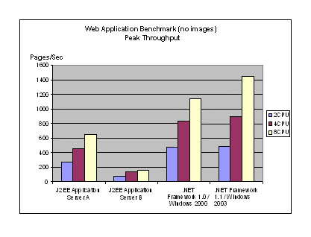
Web App Benchmark

Slide 10

Distributed Transactions

Slide 11
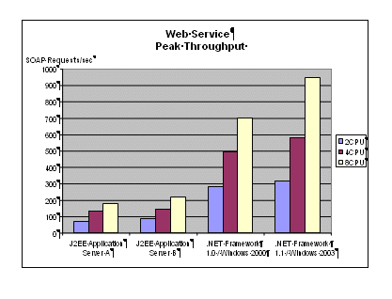
Web Service Throughput

Slide 12
Visual Studio 2005
IDE for .Net development
Dotfuscator encryption tools
Cassini (IIS)
Application Testing Center
Team Suite for project management
Express versions (free)
VB6 to VB.Net conversion wizard

Slide 13
.Net Programming Languages
Visual Basic.Net
C#
APL
Fortran
Pascal
C++
Haskell
Perl
Java Language
Python
COBOL
Microsoft JScript
RPG
Component Pascal
Mercury
Scheme
Curriculum
Mondrian
SmallTalk
Eiffel
Oberon
Standard ML
Forth
Oz

Slide 14
C# vs. VB.Net
Differences lie in:
Syntax
Object Oriented Features
Visual Studio.Net IDE

Slide 15
C# vs. VB.Net
C#
No Auto Case adjust
Requires “{, }, ;”
Enforces programming rules.
Unsafe Blocks
Documentation Comments
Operator Overloading
VB.Net
Auto case adjust
No line terminators
Requires “Begin, End”
Still intended as RAD tool.
Allows late binding

Slide 16
C# vs. VB.Net
C#
class App
{
static void Main(string [ ] args)
{
int intCounter=0;
foreach (string arg in args)
{
System.Console.WriteLine(“Counter:” + intCounter.ToString() + “=“ + arg);
} //end of foreach
} //end of Main()
} //end of App{}
VB.Net
Class App
Shared Sub Main(ByVal args as String( ) )
Dim arg as String
Dim intCounter as Integer
For Each arg in args
System.Console.Writeline(“Counter: ” & intCounter & “=“ & arg)
Next ‘For Each loop
End Sub ‘end of Main()
End Class ‘end of App{}

Slide 17
Documentation Comments (C#)
///<summary>
///A Sample Function to demonstrate C#
///</summary>
///<param name=“void”>This function does not receive a parameter. </param>
///<returns>Void Type</returns>
Void SampleProc()
{
int intCounter1, intCounter2;
MessageBox.show(“Counter1=” & intCounter1);
} //end of SampleProc

Slide 18
C#/VB.Net Myths
VB.Net is intended for use with Microsoft Office.
C# is the latest release of C++.
C# is easier to learn than VB.Net.
To learn C#, one should first learn C++.
C# is more advanced than VB.Net
C# runs faster than VB.Net

Slide 19
C#/VB.Net Converters
C# to VB.NET
http://www.aspalliance.com/aldotnet/examples/translate.aspx
http://www.kamalpatel.net/ConvertCSharp2VB.aspx
VB.Net to C#
http://www.e-iceblue.com
http://www.vbconversions.com

Slide 20
Developer Resources
Microsoft Developers Network: http://msdn.microsoft.com
.Net Training and Events: http://msdn.microsoft.com/netframework/support/training/default.aspx
Deploying .Net Applications: http://msdn.microsoft.com/library/default.asp?url=/library/en-us/cpguide/html/cpcondeployingnetframeworkapplications.asp
MSDN Events (VS.Net): http://www.msdnevents.com
TechNet Events (SQL Server): http://www.technetevents.com
C#/VB.Net Special Interest Group: http://www.ClevelandDotNet.info/

Slide 21
Informational Resources
.Net Overview http://msdn.microsoft.com/netframework/technologyinfo/overview/
What .Net means to IT Professionals
http://www.microsoft.com/net/business/it_pros.asp
Case Studies:
  Continental Airlines
  Dollar Rent A Car Systems
  U.S. Army Intelligence and Security Command
  Scandinavian Airlines
TS2 Seminars
  http://www.ts2seminars.com/

